Slide 1
New Jersey’s
Clean Energy ProgramTM
Clean Energy and Efficiency Opportunities for Residential, Commercial, Industrial, and Institutional Buildings
April 28th, 2022
Notes:
TITLE SLIDE OPTION A

Slide 2
Agenda
Introduction to NJBPU and New Jersey’s Clean Energy Program
Energy Efficiency Defined
NJCEP portfolio of program categories:
  School and Small Business Stimulus
  Local Government Energy Audit
  New Construction
  Energy Savings Improvement Program
Q&A
Notes:
Set the agenda but start with background introductions for each presenter

Slide 3


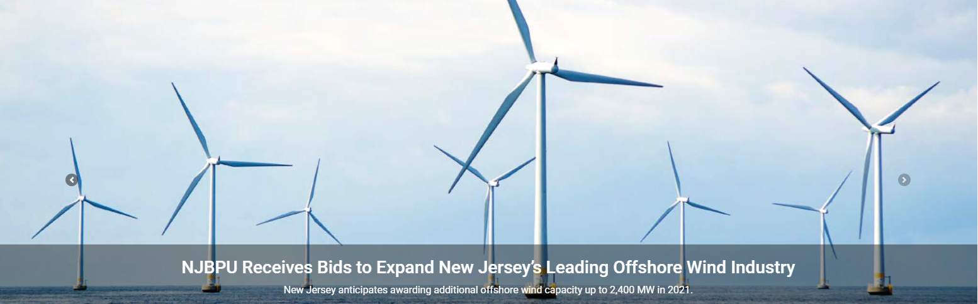
New Jersey Board of Public Utilities
The New Jersey Board of Public Utilities (NJBPU) is the state agency with authority to oversee the regulated utilities, which provide critical services such as natural gas, electricity, water, telecommunications, and cable television.
NJBPU ensures safe and adequate utility services are provided at reasonable, non-discriminatory rates by developing and regulating a competitive, economically cost effective energy policy that promotes responsible growth and clean renewable energy sources while maintaining a high quality of life in New Jersey.

Slide 4

New Jersey’s Clean Energy Program
CURRENTLY Administered by
New Jersey Board of Public Utilities’ Division of Clean Energy
CURRENTLY FundED BY
Societal Benefits Charge (SBC) on utility bill
Program Goals
Education
Change behavior
Provide opportunities for ALL NJ residents and business owners to save energy and lower operating costs
Protect the environment and reduce emissions
Meet Governor Murphy’s goal of 100% clean energy by 2050

Slide 5
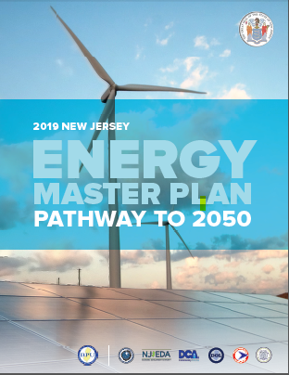
Reaching NJ’s Clean Energy Goal
100% clean energy by 2050
Strategies:
Reduce Energy Consumption and Emissions from the Transportation Sector
Accelerate Deployment of Renewable Energy and Distributed Energy Resources
Maximize Energy Efficiency and Conservation and Reduce Peak Demand
Reduce Energy Consumption and Emissions from the Building Sector
Decarbonize and Modernize New Jersey’s Energy Systems
Support Community Energy Planning and Action with and Emphasis on Encouraging Participation by Low-and-Moderate-Income and Environmental Justice Communities
Expand the Clean Energy Innovation Economy
Notes:
The main goal of the EMP is to have 100% clean energy in NJ by 2050
4 of the 7 strategies deal with energy efficiency which we will be discussing here today.

Slide 6






Addressing Climate Change in NJ
CUSTOMER Education
ENERGY CONSERVATION
“Energy efficiency is using technology that requires less energy to perform the same function”
U.S. Energy Information Administration
ENERGY EFFICIENCY
DISTRIBUTED ENERGY RESOURCES
Renewable energy
Notes:
Climate change is addressed in a hierarchy that starts with education then leads into conservation and energy efficiency before addressing resiliency and renewable energy.
Today we are doing education.
The next step is conservation which is behavioral: turn off the light, don’t idle your car
EE is mechanical: switch a light bulb, use a technology that performs the same function but uses less energy
We are focusing today on energy efficiency.

Slide 7
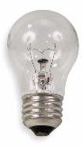
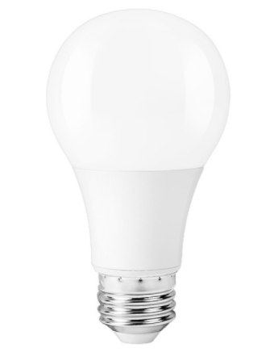
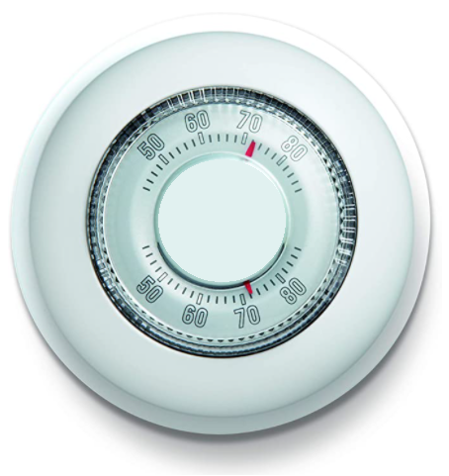
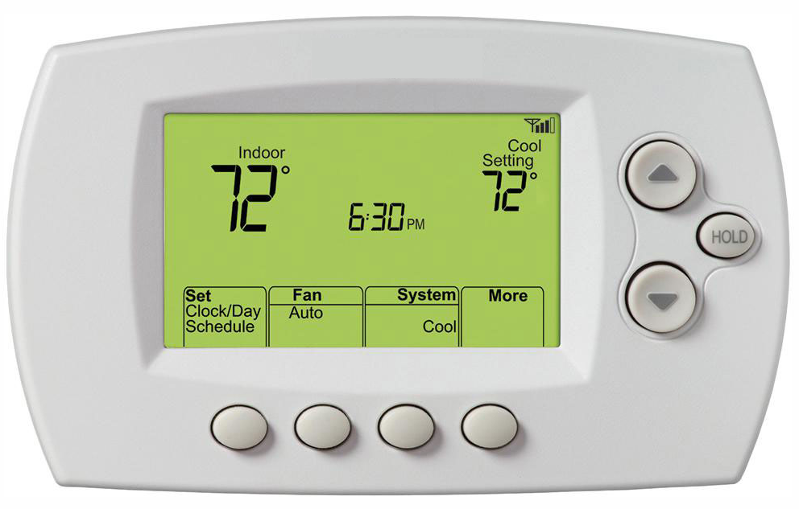
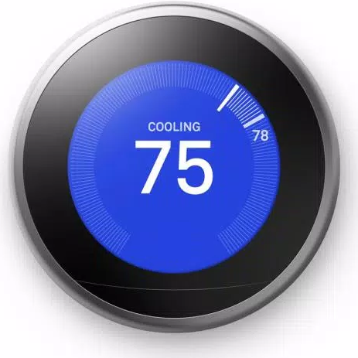
Energy Efficiency
The cheapest energy is the energy you don’t use
it is as easy as:
choosing a qualified smart thermostat
choosing a qualified LED bulb
Notes:
Projects can be as simple as replacing lightbulbs or thermostats or as complex as custom designed HVACs, fans, and controls.
(discuss making conscious decisions to replace equipment)
According to Energy Star, LED lights use 90% less than standard incandescent bulbs

Slide 8



Benefits of Energy Efficiency
Energy efficiency (EE) helps reduce greenhouse gas emissions and mitigate climate impacts, which improves health conditions
EE projects lower energy costs, especially for low- to moderate-income participants overburdened by energy bills
EE projects are labor intensive so increased EE projects strengthen the job market
Notes:
(from board order)

Slide 9



Benefits of Energy Efficiency (cont’d)
EE projects reduce energy use that can reduce energy bills for customers and allow them to reinject the funds into the economy
EE projects are designed to increase long term comfort and safety
EE projects are one of the easiest and cheapest resources against the global climate crisis
Notes:
(from board order)

Slide 10
Division of Clean Energy
The Division of Clean Energy manages and coordinates programs aimed at achieving 100% clean energy by 2050.
The Division oversees numerous projects and initiatives including:
  NJ Clean Energy Program (NJCEP)*
  Office of Clean Energy Equity*
  Energy Efficiency
  Electric Vehicles
  Offshore Wind
  Solar Programs including Community Solar
  Energy Storage

Slide 11

Energy Equity
EQUITY
  Capturing quantitative and qualitative program metrics
  Fostering meaningful and open participation to ensure equitable program outcomes
  Building trusting and reciprocal relationships with communities
  Reducing energy burden
WORKFORCE DEVELOPMENT
  Identifying and sustaining well-paying jobs that have long term career growth opportunities for diverse applicants
  Training the workforce with the necessary skills to thrive in the new energy economy
Image source: University of Michigan

Slide 12

NJCEP Portfolio of Programs
Renewable ENERGY
COMMERCIAL
& INDUSTRIAL
ENERGY
EFFICIENCY
PROGRAMS
DISTRIBUTED
ENERGY
RESOURCES
Residential
SPECIALIZED ENERGY
EFFICIENCY
Notes:
NJCEP includes many buckets of programs that include renewable energy, specialized programs, resiliency in addition to energy efficiency.
Both C&I and Residential have programs available for new construction which C&I offers some programs for existing buildings as well if they are local governments or large energy users
Both have outreach teams that work with customers, contractors, suppliers, relevant organizations, and other stakeholders.
(give overview of EE programs and inform audience of where you will be focusing)

Slide 13
Energy Efficiency
NJCleanEnergy.com
SPECIALIZED ENERGY
EFFICIENCY
COMMERCIAL & INDUSTRIAL
Residential
  Community Energy Grants
  Combined Heat and Power & Fuel Cells
  State Facility Initiatives
  Micro Grid Development
  R&D Energy Tech Hub
  Workforce Development
  Existing Buildings
    Local Gov. Energy Audits
    Large Energy Users
    School and Small Business Stimulus Program
  New Construction:
    Prescriptive & custom rebates: SmartStart Buildings
    Bundled rebates: CTEEP
    Comprehensive med-large:
    Pay for Performance
    Municipal Electric Fleets
  Residential New Construction
  Comfort Partners
  Electric Vehicles
  *Coming Soon

Slide 14
School and Small Business Stimulus
Program launched October 7, 2021
Budget - $180 Million
Goal: provide grants to boards of education and eligible small businesses for repair/installation of HVAC and plumbing fixtures and appliance.
Primary Focus:
  Air quality/air flow (COVID - driven)
  Energy efficiency / water conservation
  Assisting underserved communities
  Program information posted on NJCEP website at:
  NJCleanEnergy.com/SSBStimulus

Slide 15
Eligibility
Boards of Education include public schools, such as local school districts, consolidated school districts, regional school districts, county vocational schools, and charter schools.
  Private schools are not eligible.
  Non-profit organizations are not eligible.
Small Businesses include New Jersey-based businesses which:
  Are independently owned and operated;
  Have no more than 100 full-time employees;
  Have annual gross revenues that does not exceed $12 million; AND
  Are certified by the State as a women or minority-owned business
  https://business.nj.gov/pages/certifications

Slide 16
Incentives
NJCleanEnergy.com/SSBStimulus
Grants cover up to 75% of costs
  Utility program funding and financing may be available for the remainder.
  Program Grant Caps:
  Tier 1 – Applicants located in municipalities under 50,000 residents:
  Boards of Education - $5 million per entity combined HVAC and Plumbing
  Small Businesses - $500,000 per entity combined HVAC and Plumbing
  Tier 2 – Applicants located in municipalities with 50,000+ residents:
  Boards of Education - $5 million per entity per HVAC and per Plumbing
  Small Businesses - $500,000 per entity per HVAC and per Plumbing

Slide 17
Overview
HVAC
Plumbing & Appliances
Maintenance Pathway
Replacement/
New Pathway
Low-flow devices
Toilets
Urinals
Commercial dishwashers
Ice makers
Clothes washers
Maintain
Repair
Upgrade
New systems
Replaced systems or units

Slide 18

SSB Stimulus Application Process
NJCleanEnergy.com/SSBStimulus
1
Apply to your local utility if your utility company offers rebates for your project
Electric Providers | Commercial & Industrial Programs
Public Service Electric & Gas | Website and Email and Phone: 844-300-7734
Atlantic City Electric | Website, Email and Phone: 866-353-0007
Jersey Central Power & Light | Website, Email and Phone: 800-662-3115
Rockland Electric | Website, Email and Phone: 877-434-4100
Gas Providers | Commercial & Industrial Programs
Public Service Electric & Gas | Website and Email Phone: 844-300-7734
New Jersey Natural Gas | Website and Email Phone: 877-455-6564
South Jersey Gas | Website and Phone: 888-263-7372
Elizabethtown Gas | Website and Phone: 888-263-7372
2
Apply for the NJCEP School and Small Business Stimulus Program

Slide 19
HVAC Program
Ventilation and Energy Efficiency Verification and Repair (SSB-VEEVR)

Slide 20
Overview
HVAC
Maintenance Pathway
Replacement/
New Pathway
Maintain
Repair
Upgrade
New systems
Replaced systems or units

Slide 21

What is Assessment and Testing?
What is it?
Who does it?
Why is it important?

Slide 22
Finding Qualified Personnel
Or:
Testing and Balancing Technicians
AABC Associated Air Balance Council | https://www.aabc.com/member-locator-alphabetical-order/
NEBB National Environmental Balancing Bureau | https://online.nebb.org/nebbssa/f?p=NEBBSSA:17800:4175906800707 (search for “Testing and Balancing of Environmental Systems”)
TABB Testing, Adjusting and Balancing Bureau | https://www.tabbcertified.org/find-a-contractor/ (search for “TABB Contractor”)

Slide 23
Finding Qualified Personnel
Certified Energy Auditor
Professional Engineer (PE) | Existing engineering relationships
Certified Energy Manager Certification (Association of Energy Engineers) | Being added to NJCEP website…
Others qualified to perform ASHRAE Level II or III energy audit | Proven competency in energy billing analysis, building performance assessment (to the standard of a Level II ASHRAE energy audit), work scope development, design document review, work scope installation verification and oversight of project progress through construction. Contact SSBStimulus@NJCleanEnergy.com

Slide 24
Ineligible Costs
Grant funding may not be used for:
Costs for boilers or other types of HVAC equipment that do not directly and significantly affect ventilation or airflow.
Costs associated with the use and continuous monitoring of the carbon dioxide monitors, such as electrical improvements, subscription services, storage, and central hubs.
Purchase of equipment that is not an integral part of the project.
Consultant fees (other than those for Qualified Personnel and Certified Energy Auditors).
Equipment installed prior to Application Approval.
Notes:
Geoff
This covers both paths.
Take a breath and a slight pause. Karin to jump in with timely questions.

Slide 25
Plumbing Program
Noncompliant Plumbing Fixture and Appliance (SSB-NPFA)

Slide 26
Plumbing/Appliances - Process
Plumbing & Appliances
Application
Complete & submit application
Installation
Verification
Program site inspection
Install the equipment
Plumbing & Appliances Verification Report
Develop your scope of work and cost estimate
Low-flow devices
Toilets
Urinals
Commercial dishwashers
Ice makers
Clothes washers
Notes:
Geoff

Slide 27
What Can You Replace?
Plumbing Fixtures:
A toilet manufactured to use more than 1.6 gallons of water per flush.
A urinal manufactured to use more than one gallon of water per flush.
A showerhead manufactured to have a flow capacity of more than 2.5 gallons of water per minute.
An interior faucet that emits more than 2.2 gallons of water per minute.
Notes:
Geoff

Slide 28

What Can You Replace?
Appliances:
Commercial dishwasher manufactured before January 1, 2010 that does not meet the efficiency requirement of the ENERGY STAR® Product Specification for Commercial Dishwashers, Version 1.1.
An automatic commercial ice maker manufactured before January 1, 2010 that does not meet the efficiency requirement of the ENERGY STAR Product Specification for Automatic Commercial Ice Makers, Version 1.0.
A commercial clothes washer manufactured before January 1, 2010 that does not meet the efficiency requirement of the ENERGY STAR Product Specification for Clothes Washers, Version 5.0.
Rule of Thumb – Is it more than 10 years old?
Notes:
Geoff
Your best bet – how old is it? Is it EnergyStar labelled?

Slide 29
Plumbing & Appliance – Payment Milestones
Payment 1
Eligible Costs
Equipment costs
Labor costs
Project Completion
100% of grant
Notes:
Geoff

Slide 30
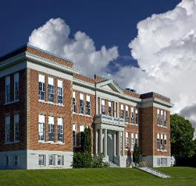
Plumbing/Appliance - Example
Hypothetical Example:
1 School
Assorted Restrooms
Kitchen with dishwasher
Example Budget
 | Materials & Labor per unit | # of Units | Total Cost
Installation
Faucet Aerators | $10 | 40 | $ 400
Toilets | $776 | 40 | $ 31,050
Urinals | $604 | 30 | $ 18,113
Commercial Dishwasher | $12,000 | 1 | $ 12,000
Total Project Cost |  |  | $ 61,563
Grant Funding (75%) |  |  | $ 46,172
Customer Commitment (25%) |  |  | $ 15,391
Notes:
Geoff

Slide 31
Ineligible Costs
Grant funding may not be used for:
Purchase of equipment that is not an integral part of the project.
Consultant fees (other than those for Qualified Personnel and Certified Energy Auditors).
Equipment installed prior to Application Approval.

Slide 32
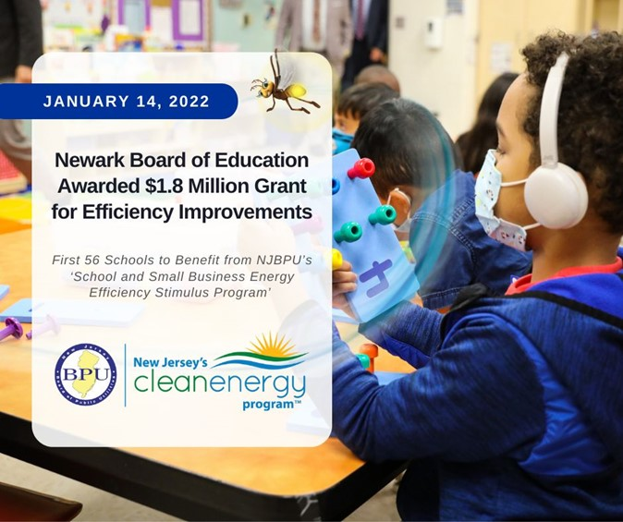
NJBPU LinkedIn:

Slide 33
Resources
Program website
  NJCleanEnergy.com/SSBStimulus
Woman and Minority-owned Business Certification (FREE)
  https://business.nj.gov/pages/certifications
Lear more about indoor air quality in schools
  EPA’s Energy Savings Plus Health: Indoor Air Quality Guidelines for School Building Upgrades
  EPA’s School Indoor Air Quality Assessment Mobile App
Notes:
Geoff
Hand off to Karin

Slide 34
Local Government Energy Audit
Existing buildings
NJCleanEnergy.com/LGEA
WHO
Local Government, New Jersey Colleges and Universities, and 501(c)(3) Non-Profit buildings with an average yearly demand >200kW*
Includes Benchmarking
Cost
Free
WhY
  Inventory of all energy-consuming equipment and line by line program eligibility, savings and costs
  Comprehensive utility bill analysis
  Facility benchmarking
  Feasibility for solar and combined heat & power
INCENTIVE CAP
  $100,000 per entity (covers most small to large entities)
  $300,000 per 501(c)(3) hospital
  $300,000 per entity interested in ESIP**
Inquire about the waivers available to buildings ≤200kW average
**Subject to BPU Approval

Slide 35
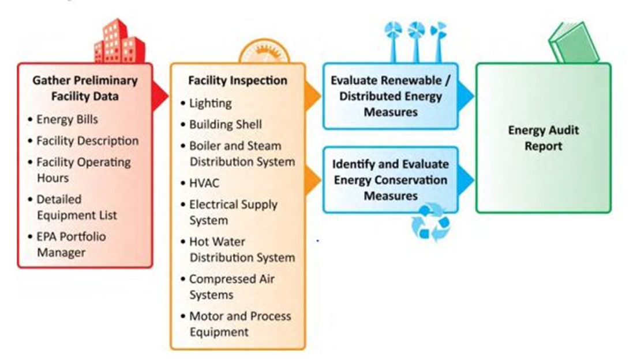
Local Government Energy Audit
Existing buildings
NJCleanEnergy.com/LGEA

Slide 36
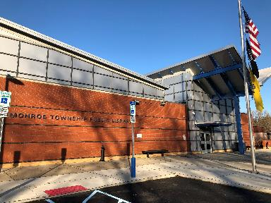
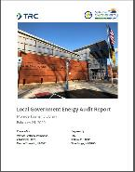
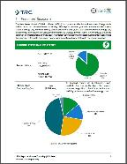
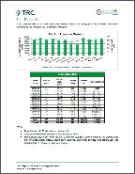
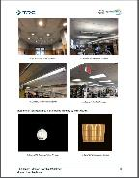
Example outcome in your area:
Monroe Township Library
LGEA in February 2020
Audit report
  identify potential energy efficiency opportunities
  help prioritize specific measures for implementation
  provide information about financial incentives that may be available.
Suggested Measures
Lighting Upgrades Lighting Control Measures Motor Upgrades VFD Measures | Unitary HVAC Domestic Hot Water Food Service Refrigeration
Total Audit Cost: $0.00 Identified annual savings: 169K KWh in electricity + 75MMBtus in fuel = $24K
Copies of reports are posted on the NJCEP website!
Notes:
The Monroe Township Library took the first step toward a successful Energy Efficiency project by getting a free Local Government Energy Audit performed on their Library .
With a potential to save over 169,000 annual kWh of electricity and 75 MMBtus in fuel savings the Monroe Public Library would also be saving an estimated $24,207 annually on their electric and gas utility expenses.
With a Smart Start prescriptive incentive estimated at $24, 572 that would result in a net project cost of $91,562 the simple payback period was estimated at 3.8 years and reduced CO2 emissi0ns by 179,672.

Slide 37






New Construction
New Construction
NJCleanEnergy.com
Any size C&I new construction or gut rehab project may be eligible for energy efficiency incentives.
New construction/gut-rehab projects must exceed ASHRAE 90.1-2016.*
Savings Potential | Program | Description
 | Whole Building/ Comprehensive: Pay for Performance Program | Designed for buildings with 50,000 square feet for more of planned conditioned space.
 | Multi-Measure: Customer Tailored Energy Efficiency Program | Bundle multiple prescriptive and custom measures into a single application. Includes eligibility for technical assistance incentives to help offset soft costs associated with custom measure development.
 | Single Measure: SmartStart Buildings Program | Prescriptive and Custom incentives.
Notes:
Self explanatory

Slide 38

Substantial Renovation (Gut Rehab)
New Construction
NJCleanEnergy.com
NJCEP programs for new construction* include substantial renovation and gut rehabilitation:
Change of use and reconstruction of an existing building
Construction work of a nature requiring that the building or portion of the building within be out of service for at least 30 days
Reconstruction of a vacant
structure or a portion of the
building within
* A licensed professional architect or engineer must have prepared or certified the building plans

Slide 39

SmartStart Buildings (SSB)
Single measure: New Construction
NJCleanEnergy.com
WHO
  New Construction C&I Projects: commercial, industrial, agricultural, government, non-profit institutional, and multifamily customers
SIZE TO QUALIFY
  N/A
ABOUT
  Individual high efficiency equipment rebates for new construction, and gut rehab projects.
  Prescriptive and custom designed measures
INCENTIVE CAP
C&I New Construction - $500,000 per electric account and $500,000 per natural gas account, per fiscal year.
  Custom, lesser of the following:
    $0.16/kWh and/or $1.60/therm saved annually;
    50% of incremental installed cost; and
    Buy-down to 1 year payback based on incremental cost and savings
Notes:
The first program within new construction is known as Smartstart. This program is available for all C&I new construction projects and there is no size to qualify. This is simply a single measure rebate program – so if you are planning on installing energy efficient equipment in your new facility or within an expansion or gut rehab, you may be eligible to receive rebates for those items.
A great thing about smart start program is that you have 12 months after purchase and installation to apply for a rebate. Most equipment designated as energy star or DLC for lighting is included within our prescriptive list. This list will clearly show the equipment type and the associated incentive.
For custom designed measures the incentives are a little different and they are calculated based on the lesser of the three categories shown at the bottom of the slide - based on energy savings,installed cost or the payback period.
An important note here is that our legacy SmartStart program for existing buildings is still accepting applications if the equipment was purchased before July 1 as the utility programs will only give incentives for equipment purchased after that date.

Slide 40
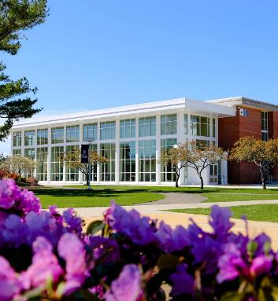
OCEAN COUNTY COLLEGE
Google Earth
Education
Lighting upgrades
  Exterior LED Wall Packs
Total Project Cost: $7,710
Incentive: $6,000
Annual Savings: $6,844
Project Payback: 3 months
This case study was from a previous fiscal year and may not represent current incentive levels or costs.

Slide 41
Customer Tailored Energy Efficiency (CTEEP)
Bundled:
New Construction
NJCleanEnergy.com
WHO
  New Construction C&I customers seeking a streamlined/single application for participants submitting for multiple different technology types. Those unwilling/uninterested in P4P.
SIZE TO QUALIFY
  N/A
ABOUT
  On site assistance available
  One application form for multiple prescriptive or custom measures
  Utilizes SmartStart Incentives
  Additional $10,000 technical incentive available to offset soft costs associated with developing and planning custom projects
INCENTIVE CAP
  Up to $500,000 for each electric or gas account
  Same Prescriptive or Custom incentives as the SmartStart New Construction Buildings program

Slide 42
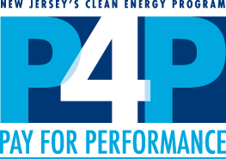
Pay for Performance (P4P)
Mid-LARGE:
New Construction
NJCleanEnergy.com
  New construction projects seeking two or more energy efficiency measures with a minimum 5% savings compared to ASHRAE 90.1-2016 (15% savings for Multifamily).
WHO
SIZE TO QUALIFY
  Over 50,000 square feet of planned new construction or gut rehab*
  A pre-approved Participating Partner will streamline the program and guide users through the program phases
ABOUT
Incentive CAP
  50% of project cost up to $2M per project / $4M per entity annually

Slide 43



Pay for Performance (P4P)
Mid-LARGE:
New Construction
NJCleanEnergy.com
1 year
Program Enrollment
Submission and Approval of Application
Energy Reduction Plan (ERP)
Development and Approval
Installation of Measures
Installation Verification
Verification of Savings
Comparison of Performance vs ERP
As-built Energy Reduction Plan & Commissioning Report
Incentive #1
fixed
Incentive #2
up to 25%
project cost
Incentive #3
up to 25%
project cost

Slide 44
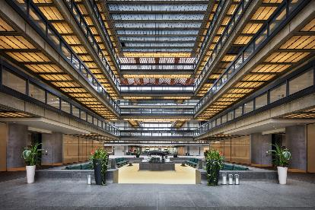
Bell Works (Somerset Holmdel LLC)
New construction (Gut Rehab)
LED lighting, Controls, high-efficiency HVAC, AHU heat recovery, Fan coils and VFDs.
Total Project Cost: $4,202,510
Incentive: $2,000,000
Annual Cost Savings: $480,305
Payback period: 4.6 years
This case study was from a previous fiscal year and may not represent current incentive levels or costs.

Slide 45
Electric Vehicles (EVs) in the Energy Master Plan
The EMP’s first strategy and goal is: “Reduce Consumption and Emissions from the Transportation Section”
Goal of 330,000 light duty electric vehicles by 2025
Charging infrastructure
State light-duty fleet
Increase transportation options, encourage new options
Decrease “Vehicle Miles Traveled”
Reduce Port emissions

Slide 46
Clean Fleet Program
Electric vehicles are now included on the State Purchasing Contract under Award T0099
Clean Fleet Electric Vehicle Incentive Program
Designed to encourage local and state government entities to add EVs to their fleet
$4,000 per battery electric vehicle and
    $1,500 for Level-Two EV charging station
    Grants awarded on rolling basis until funding expended
Questions? EV.programs@bpu.nj.gov

Slide 47
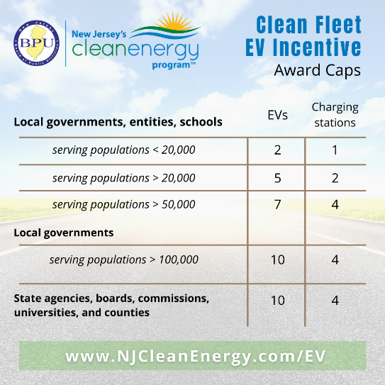

Slide 48
Financing for government Agencies

Slide 49

Financing Mechanism: ESIP
Energy Savings Improvement Program (ESIP)
    Energy Performance Contracting – NJ ESIP
    Financing Mechanism that allows state entities to make energy efficiency improvements without impacting their budgets
    Administered by the NJBPU
    Project is paid for with the value of its own energy savings
    15 or 20-year self-funding loan
    Recent Energy Efficiency Transition
        NJBPU Approved Incentive Programs: Utility or NJCEP
    Can be combined with Federal/State Pandemic Relief Funds
    No upfront capital expenses
    No referendum or impact to taxpayers

Slide 50



Financing Mechanism: ESIP
Preliminary Energy Audit
LGEA
Select Path
ESCO Model
Hybrid Model
DIY Model
Investment Grade Energy Audit
Prioritize ECM’s to determine project
Energy Savings Plan Developed
Cash Flow Positive
Third Part Audit of Plan
Submit to
BPU for Approval
Notes:
Step 1: Energy Audit completed for entity building (LGEA satisfies this requirement)
Step 2: BPU approves ESIP RFP
Step 3: Entity issues ESIP RFP & selects ESCO or DIY approach
Step 4: Investment grade energy audit completed & Energy Savings Plan (ESP) developed
Step 5: Third party review of ESP
Step 6: Review and approval of ESP by BPU
Step 7: BPU approves ESIP RFP
Step 8: Entity adopts ESP, determines guarantee

Slide 51
Energy Savings Improvement Program
FOR MORE INFORMATION
Michelle Rossi
ESIP Coordinator
ESIP@bpu.nj.gov
o: 609.633.9641
c: 609.915.0903

Slide 52
More Information

Slide 53
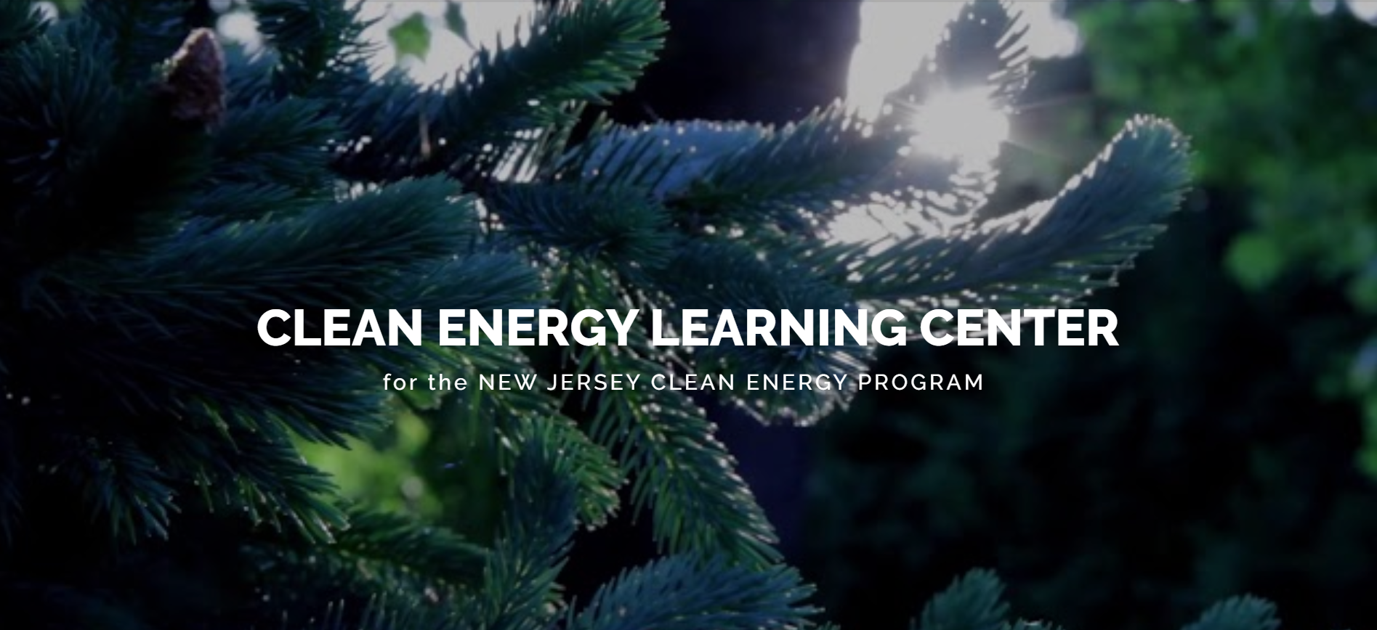
Clean Energy Learning Center
NJCELC.com
Online program overviews for customers and contractors

Slide 54


More Information
inquiries:
outreach@njcleanenergy.com
Visit
NJCleanEnergy.com
Newsletter
NJCleanEnergy.com/NEWSLETTER
EE Listserv
NJCleanEnergy.com/LISTSERVS
@NJCleanEnergy
oneika mcbean
Community Outreach
oneika.mcbean@clearesult.com
609.423.3829
EZ ukponu
New Construction
EUkponu@trccompanies.com
732.570.7534
Notes:
[use this slide or the previous slide]
BPU is welcome to use Outreach@NJCleanEnergy.com

