Slide 1

Law, Ethics and Governance for All Leaders, including an Overview of New and Emerging Issues
Addressing Progressive Discipline and HR Issues for Non-Union, Custodial & Maintenance, and Administrative Support Staff
November 16, 2023
David Nash, Esq.
Director of Legal Education and National Outreach

Slide 2
DISCLAIMER
This presentation is intended as a summary of law only and is not meant as legal advice. Please consult your attorney to obtain legal advice.
Participants are authorized to use the LEGAL ONE materials provided in this training to offer turnkey training within the respective participant's school district or place of employment, provided that participants provide proper credit to LEGAL ONE for having developed said materials and further provided that such turnkey training is offered at no charge.

Slide 3
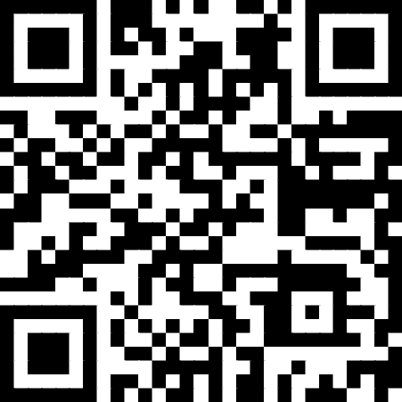
Presentation Materials
Today’s document(s) can be accessed at
https://tinyurl.com/LO-BCASBO-231116
This folder can be accessed for 30 days from the session date.
Please download all files before the link expires.

Slide 4
LEGAL ONE and Arthur J Gallagher
Great partnership, over many years
For 2023-24, includes:
  access to a series of half-day webinars
  New season of The LEGAL ONE Podcast focused on Equity and the Law aired September/October and available at https://njpsa.org/the-legal-one-podcast/
  Access to School Law Central newsletter (latest issue in Dropbox folder)

Slide 5
LEGAL ONE and Arthur J Gallagher
2023-24 Half-Day Sessions (9 – 12 via Zoom)
July 13 – Evolving Legal Requirements in Human Resources (recording available)
August 9 – School Ethics
September 14 – Hot Issues in School Law
November 9 – ABCs of Progressive Supervision
December 14 – Student Searches and School Security
February 8 – Legal Requirements Related to Addressing Microaggressions and Implicit Bias

Slide 6
Key Topics
Employee rights and human resource protocols for non-union and non-certificated staff members.
Key aspects of progressive discipline
Impact of P.L. 2021, c. 66
Lessons from recent case law
Sick Leave Expansion

Slide 7
Employee rights and human resource protocols

Slide 8
Staff Member Rights
Citizens
  Constitutional Rights (e.g., First Amendment, Fourth Amendment, Fifth Amendment, Fourteenth Amendment)
Disability
  Interactive Process
  Reasonable Accommodation
Bargaining Unit Member
  CBA, Grievance definition, Weingarten
  PERC (any discipline, ULP)
Non-tenured Employee
  (Protection from discrimination, CBA, notice)
Tenured Employed
  Added due process
Whistleblower/Non-Retaliation
Non-Certificated Staff Member
  Chapter 66

Slide 9
Latest Guidance on
Employee Use of Cannabis
May have policy allowing for immediate medical exam for staff suspected of being under the influence
If staff suspected of using cannabis, need to engage in two-step testing process
See September 2022 Guidance from Cannabis Regulatory Commission
  A scientifically reliable objective testing method that indicates the presence of cannabinoid metabolites in the employee’s bodily fluid alone is insufficient to support an adverse employment action. However, such a test combined with evidence-based documentation of physical signs or other evidence of impairment during an employee’s prescribed work hours may be sufficient to support an adverse employment action.
See Model Form - Reasonable Suspicion Observed Behavior Report
  Physical Signs
  Behavioral Signs
  Other Evidence

Slide 10
Progressive Supervision
& P.L. 2021 Chapter 66

Slide 11
Progressive Discipline
A review of the Tenure Cases demonstrates that one of the primary reasons that employees are not terminated when Tenure Charges are filed is due to a lack of “Progressive Discipline”
School Districts must be able to demonstrate that the employee has been given notice of the problem and that there have been legitimate attempts by the School District to solve the problem prior to the step of seeking termination.
Egregious behavior such as Sexual Misconduct or endangering a student / staff member do not necessarily need to show a history of “Progressive Discipline”

Slide 12
Progressive Discipline
Definition: The actions are remedial, increasingly more severe, proportionate and appropriate to the nature of the problem.
Examples:
Verbal warning/discussion
Letter of reprimand
Recommendations to withhold increment
Recommendation for suspension/dismissal
Things to consider when weighing degree of discipline:
Intention
Number of occurrences
Previous corrective measures
Time frame
Severity

Slide 13
Non-Certificated Staff Members
P.L. 2020, c.66 (8/13/2020) – Employees who are not teaching staff members (non-certificated staff) shall have the right to submit to binding arbitration (through the contractual grievance procedure) any dispute regarding whether there is just cause for a disciplinary action, including, but not limited to:
  reprimands, withholding of increments, termination or non-renewal of an employment contract, expiration or lapse of an employment contract or term, or lack of continuation of employment,

Slide 14
Non-Certificated Staff Members
P.L. 2020, c.66 (8/13/2020) The ability to submit these matters to binding arbitration is irrespective of the reason for the employer's action or failure to act, and irrespective of any contractual or negotiated provision or lack thereof.
In the arbitration, the burden of proof shall be on the employer.
Nothing in this section shall be regarded as affecting the right of any teaching staff member or majority representative to submit to binding arbitration any dispute involving or relating to a teaching staff member.

Slide 15
Just Cause Test
1. FAIR NOTICE Did management make the worker aware of the rule or policy which they are being accused of violating?
2. PRIOR ENFORCEMENT Has management recently enforced the rule or policy or penalized other workers for violating the same rule or policy?
3. DUE PROCESS Did management conduct an interview or hearing before issuing the discipline, take action promptly and list charges precisely?
4. SUBSTANTIAL PROOF Was management’s decision to accord discipline based on credible and substantial evidence?
5. EQUAL TREATMENT Is the punishment management is proposing consistent with the punishment other workers received for the same or substantially similar offense?
6. PROGRESSIVE DISCIPLINE During the disciplinary process, did management issue at least one level of discipline that allowed the employee an opportunity to improve?
7. MITIGATING AND EXTENUATING CIRCUMSTANCES Was the discipline proportional to the gravity of the offense, taking into account any mitigating, extenuating or aggravating circumstances?

Slide 16
Lessons from case law

Slide 17
Egregious Conduct Examples
Spitting on a student
  Lat Sall v. SOSD of City of Paterson - 5/13/15
Helping students cheat on a test
  Radzik v. Woodbridge Township - 8/4/14
Condoning / participating in a drug deal
  Hamilton Township BOE v. Young - 5/2/14
Inappropriate communications with students
  Blackhorse Pike Reg. SD v. Clune - 8/18/14
Assaulting a student
  Barnes v. SOSD Paterson - 3/24/15
Inappropriately “touching” / harassing a student
  Dunckley v. Rockaway Twp BOE - 6/13/16
  Davis v. SD of Asbury Park - 5/15/14
Inappropriate personal conduct outside of school / streaking
  Bringhurst v. Vineland SD - 11/30/12

Slide 18
Staff to Student Harassment
In the Matter of Tenure of Marvin Davis, Sch. Dist. Of Asbury Park, Monmouth County (5/15/14)
A parent reported that she observed the custodian touch her daughter’s hair, which caused discomfort to the child. Upon further investigation, the School District learned that the custodian had engaged in conduct involving several students which included:
  pulling students’ hair so as to cause the students’ heads to bend backwards,
  patting students on the back, and sneaking up on students.
The custodian admitting to touching the students’ hair and tapping some students on the shoulder, but claimed that he was just “playing around”, that touching the students’ hair was “natural”, and that he had not intended to make any of the students uncomfortable.
The custodian had been involved in similarly related incidents at two other schools, and had been counseled about inappropriate interaction with a pupil during his probationary period.
The Arbitrator determined that the tenured custodian engaged in conduct unbecoming a staff member that was flagrant and unjustifiable. The custodian had clearly violated a central tenant of the School District’s fiduciary responsibility with respect to its students, had violated the trust of the students’ parents, and probably would not refrain from engaging in this activity in the future.

Slide 19
April 2022 Case on Working Partial Days
Johns & Lopez v. Belleville SD – 4/18/22
Absences:
  Failure to Report & Excessive Absenteeism – 2 Night Custodians
  Left position 1 hr 15 minutes early multiple times (3pm-11pm) – March 2021 (believes happened prior as well)
  Did not seek permission to leave early
  Teachers/Staff noted the lack of “cleanliness” of the building and other issues
    During Covid-19 period – Additional Health Protocols / danger to staff/children
  Pulled video and discovered leaving early frequently
Prior Discipline:
  Johns – No prior Discipline
  Lopez – Has Letters of Reprimand (2008-2014) included issues with injuries
    17 years of service with no discipline in the last 7 years
Defense:
  Claims had been told that once the work was done, they could leave early (denied)
  They had reported to work early, so they were still completing the required hours of work
  Fluctuation of schedules led to confusion
  Thought that head custodian was there direct supervisor
  Lopez & Johns remorseful
Holding:
  Received full pay for working less than required 8.5 hours
  Claim of creating a dangerous situation for staff/students not supported by examples
    Dust / Unclean Marker Boards does not equal a “dangerous situation”
  Credible confusion as to who could give permission to leave early
  Demonstrated a lack of judgment
  Reinstate w/o Back Pay
  Termination Time Converts to Unpaid Suspensions

Slide 20
Tenure Case Comparison – Alcohol Issues
Monaco v. East Hanover Township SD - 12/1/14
  Tenured teacher arrested for Drunk Driving in the town in which she taught
  While being arrested, she told police that they couldn’t arrest her because she was a teacher in the town and was “friends” with the Mayor.
  Refused to admit that she had been “in the wrong” (this was her second DUI)
  Tenure charges granted – Teacher terminated.
Zepralka v. Greater Egg Harbor Regional High Sch. Dist. BOE - 9/4/15
  Tenured 19 year secretary, with no prior disciplinary record, caught consuming alcohol on school property, during school hours
  Secretary admitted she had a problem and checked herself into Rehab.
  Secretary completed Rehab program and was medically cleared to return to work.
  SD had a Zero Tolerance Policy – said that she could not RTW and filed CU Tenure Charges seeking Dismissal
  Secretary was allowed to RTW with a “Last Chance Agreement”.

Slide 21
Interactive Process Critical
Taylor v. Phoenixville Sch. Dist., 184 F. 3d 296 (3rd Cir. 1999)
No need for “magic words” to put employer on notice
Secretary served for 20 years, glowing evaluations
Hospitalized and diagnosed with bipolar disorder
Brought suit under ADA
Court reversed summary judgment for district, held district was on notice and had not engaged in meaningful “interactive process”
  Learn precise nature of disability
  Discuss potential accommodations

Slide 22
Sick leave expansion

Slide 23
P.L. 2023, c. 95
Permitted Sick Leave Uses
(1) the employee is personally ill or injured;
(2) for diagnosis, care, or treatment of, or recovery from, an employee's mental or physical illness, injury or other adverse health condition, or for preventive medical care for the employee;
(3) for the employee to aid or care for a family member of the employee during diagnosis, care, or treatment of, or recovery from, the family member's mental or physical illness, injury or other adverse health condition, or during preventive medical care for the family member;

Slide 24
Permitted Sick Leave Uses
(4) absence necessary due to circumstances resulting from the employee, or a family member of the employee, being a victim of domestic or sexual violence, if the leave is to allow the employee to obtain for the employee or the family member:
  (a) medical attention needed to recover from physical or psychological injury or disability caused by domestic or sexual violence;
  (b) services from a designated domestic violence agency or other victim services organization;
  (c) psychological or other counseling;
  (d) relocation; or
  (e) legal services, including obtaining a restraining order or preparing for, or participating in, any civil or criminal legal proceeding related to the domestic or sexual violence;

Slide 25
Permitted Sick Leave Uses
(5) the death of a family member for up to seven days;
(6) to attend a child’s school-related conference, meeting, function or other event requested or required by a school administrator, teacher, or other professional staff member responsible for the child's education, or to attend a meeting regarding care provided to the child in connection with the child's health conditions or disability;
(7) the school or place of care of a child of the employee is closed by order of a public official or because of a state of emergency declared by the Governor, due to an epidemic or other public health emergency;

Slide 26
Permitted Sick Leave Uses
(8) the employee has been exposed to a contagious disease or is quarantined for the disease in the employee’s immediate household.

Slide 27
Liberal Construction
New law is intended to expand uses of sick leave, will be liberally construed
In addition to any existing benefits
Cannot mandate concurrent use with other leaves unless agreed upon with collective bargaining unit

Slide 28
Excessive Absenteeism Assessment Criteria
Excessive absenteeism / tardiness is actionable, even if the absences are "justified". There are 3 elements that must be satisfied to warrant termination in an absenteeism case:
  1. The particular circumstances of the absences and not merely the number of absences;
  2. The impact that the absences had on the continuity of instruction during the period of time the absences occurred, not merely after the fact (i.e. - show how the staff member’s excessive absenteeism has negatively affected the school and/or students); and
  3. That there be some warning given to the employee that his/her supervisors were dissatisfied with the pattern of absences. Written warnings/improvement plans/ counseling of past infractions with no indication of improvement by the staff member can be evidence that indicates that the staff member will not improve with “another chance.”

Slide 29

Conclusion
Thank you for choosing professional development with LEGAL ONE!
Visit our website for more courses that can support your work at http://www.njpsa.org/legalonenj/
Participants are authorized to use the LEGAL ONE materials provided in this training to offer turnkey training within the respective participant's school district or place of employment, provided that participants provide proper credit to LEGAL ONE for having developed said materials and further provided that such turnkey training is offered at no charge.
If you have any questions about this presentation or suggestions for future seminars, please send an email to legalone@njpsa.org

Slide 30
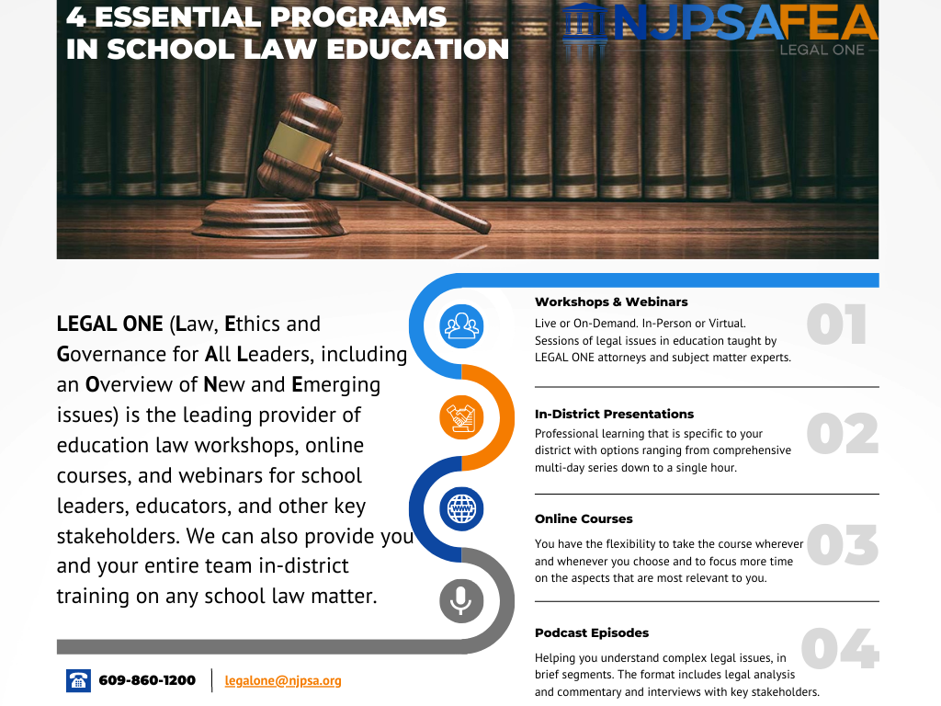

Slide 31
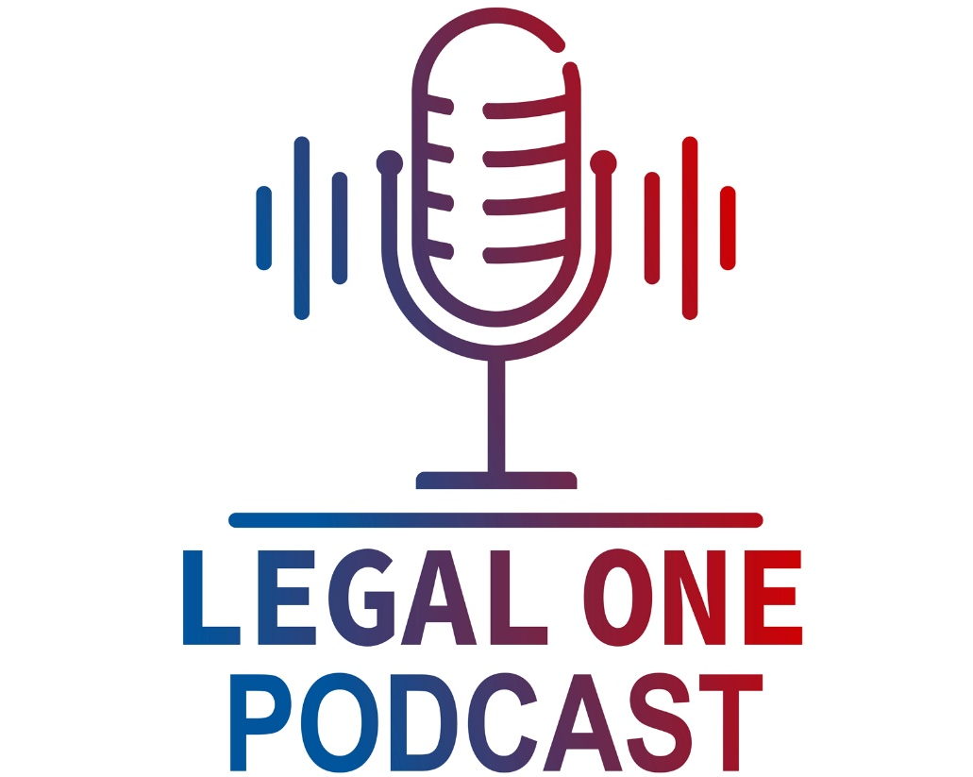



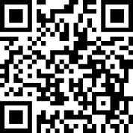
http://njpsa.org/the-legal-one-podcast/
Available in Apple Podcasts, Google Podcasts, and Spotify.
How can you understand your legal rights and responsibilities? Especially with limited time, laws that are constantly evolving, and the fact that you are always on the move? Whether you are a parent, teacher, school leader, college student or just have an interest in school law, the LEGAL ONE Podcast provides a great option for you.
As the leading provider of school law training, the LEGAL ONE team of school law experts is pleased to offer the LEGAL ONE Podcast, a weekly podcast that helps you understand complex legal issues. Each episode will be hosted by a LEGAL ONE attorney, include information on recent developments in school law and provide tips for promoting collaboration between parents and schools.

