Slide 1
Bergen County Association of School Business Officials April 16, 2020 9:00 – 10:00am
Negotiating In These Times

Slide 2
Philip E. Stern
15 Mountain Boulevard
Warren, New Jersey 07059
Phone: 908-757-7800, ext. 141
Fax: 908-757-8039 pstern@newjerseylaw.net

Slide 3
Section 508 of the Rehabilitation Act
Section 508 was made part of the Rehabilitation Act of 1973 in 1998.
Its purpose is to “…require Federal agencies to make their electronic and information technology (EIT) accessible to people with disabilities.”

Slide 4
A Thought About Negotiations…..
Negotiations =
FOUNDATION,
Not
Feature

Slide 5
Another Thought About Negotiations…..
Negotiations =
FOUNDATION
And
TRANSFORMATION

Slide 6
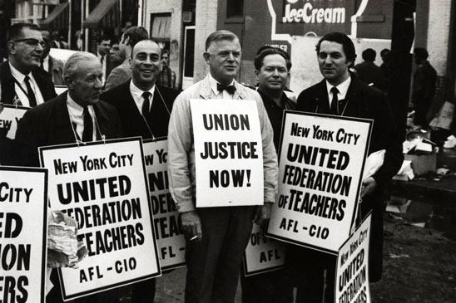
The dawn of the nation’s educational collective bargaining arose on April 11, 1962, in New York City, when five thousand members of the United Federation of Teachers went on strike. Thereafter, following Wisconsin’s initial incursion into educational collective bargaining in 1959, New York State passed laws recognizing collective bargaining in education.

Slide 7
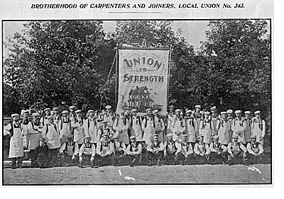
Industrial Unionism in Educational Bargaining
Teacher collective bargaining took its cues from the unionism of America’s industries. When collective bargaining came to education, unions of educators used patterns of bargaining transported nearly wholesale from the nation’s factories. Thus, state teacher collective bargaining laws closely resemble the federal private sector statute.

Slide 8
Bargaining and Student Achievement
More recent research at Rutgers University (Rubinstein and McCarthy 2014) demonstrated that formal union-management committees and partnerships improve student achievement even in high poverty schools. Formal partnerships help improve student performance. The quality of formal partnerships between teachers unions, administrators, and teachers at the school level is a significant predictor of student performance, as well as performance improvement, after poverty and school type are taken into account.

Slide 9
WE BARGAIN THIS WAY BECAUSE WE BARGAIN THIS WAY

Slide 10
Some Options….

Slide 11
Key Considerations….
Preparation
Creativity
Discipline
Courage

Slide 12
What Is the Role of the SBA?
STEREOTYPICAL ROLE | BETTER ROLE

Slide 13
A Case Study……Teaneck

Slide 14
Bargaining In the Era of Coronavirus……
Questions to Ask:
1. What has changed?
2. What should change?
3. How should the process work?
4. What are our objectives?

Slide 15
Ideas to Ponder…..
Stagger start-times or school days by grade level to reduce overall school density.
Reduce class size to reduce classroom density.
Move all high school classes to online only. Use the now vacant schools to house elementary or middle school classes.
Livestream performances, athletic competitions, and awards ceremonies.
Allow for outside picnic areas at lunch
Offer online classes as an option for motivated students and teachers. Give priority for teaching online courses to teachers who are defined as “high risk” (over 60 and/or with underlying health issues.)

Slide 16
Selected Bibliography
Bowling and Hoffman, Bringing Peace into the Room, John Wiley and Sons, 2003
Fisher and Ury, Getting to Yes, Penguin Books, 2011
Hannaway and Rotherham, Collective Bargaining in Education: Negotiating Change in Today’s Schools, Harvard Education Press, 2010
Kaboolian and Sutherland, Win-Win Labor-Management Collaboration in Education, Education Week Press, 2008
Odden and Kelley, Paying Teachers for What They Know and Do: New and Smarter Compensation Strategies to Improve Schools, Corwin Press, Inc., 1997
Janus v. AFSCME , CERTIORARI TO THE UNITED STATES COURT OF APPEALS FOR THE SEVENTH CIRCUIT No. 16–1466. Argued February 26, 2018—Decided June 27, 2018

